Slide 1
Credit Card Dataset for Clustering Using K-Means By / Omnia Elmenshawy
Ecodation Artificial Intelligence Internship

Slide 2
Libraries Used:
EDA
Preprocessing
Modeling
Model Evaluation
Agenda:
Pandas
Numpy
Seaborn
Scippy
Matpoltlib
Missingo
Sklearn
Yellowbrick
DataPrep

Slide 3


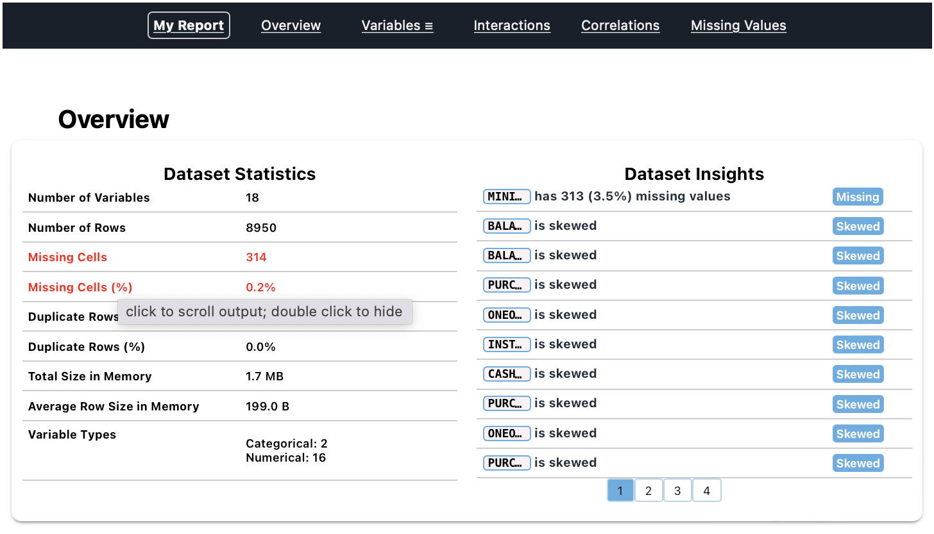
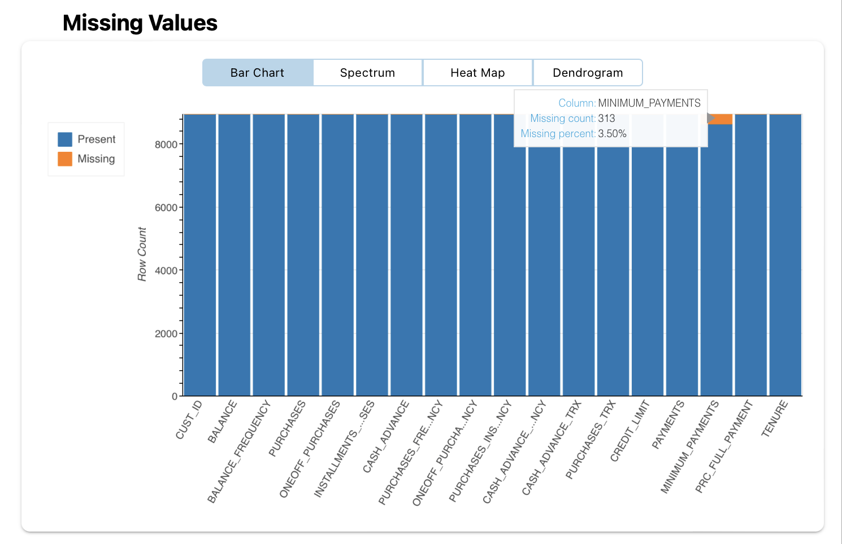

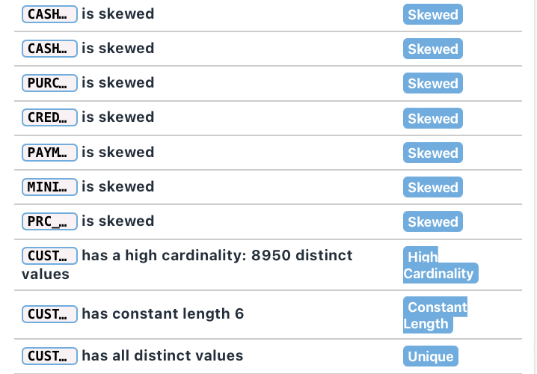
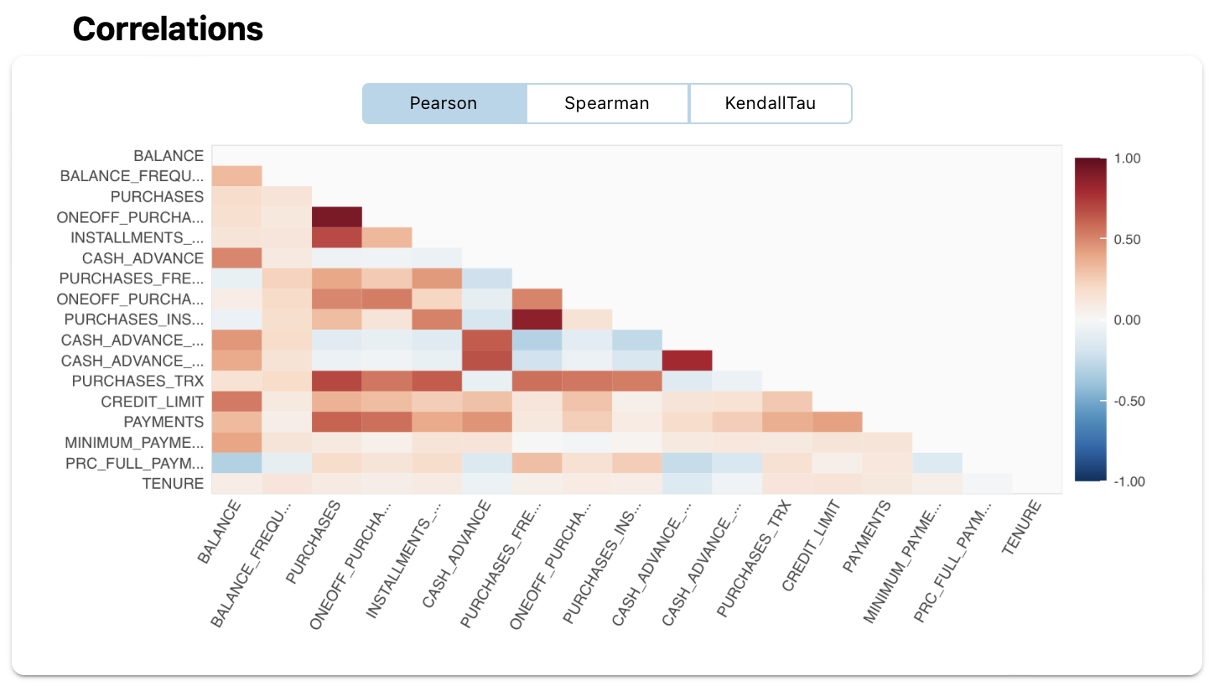
EDA & Preprocessing: 1. Report

Slide 4
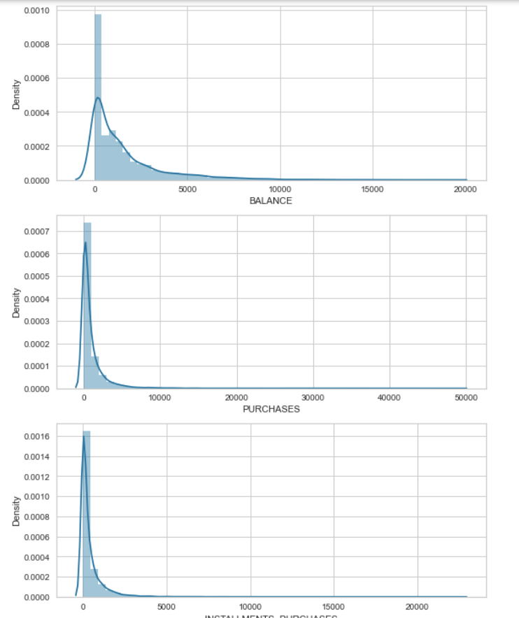
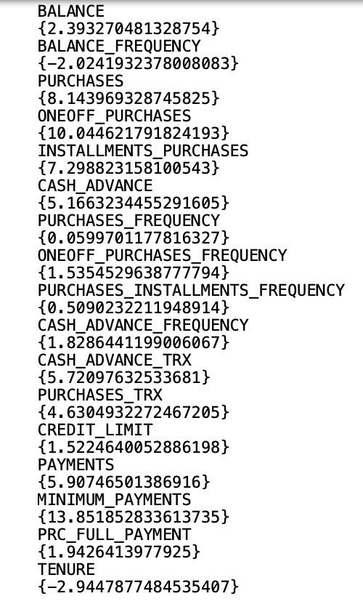
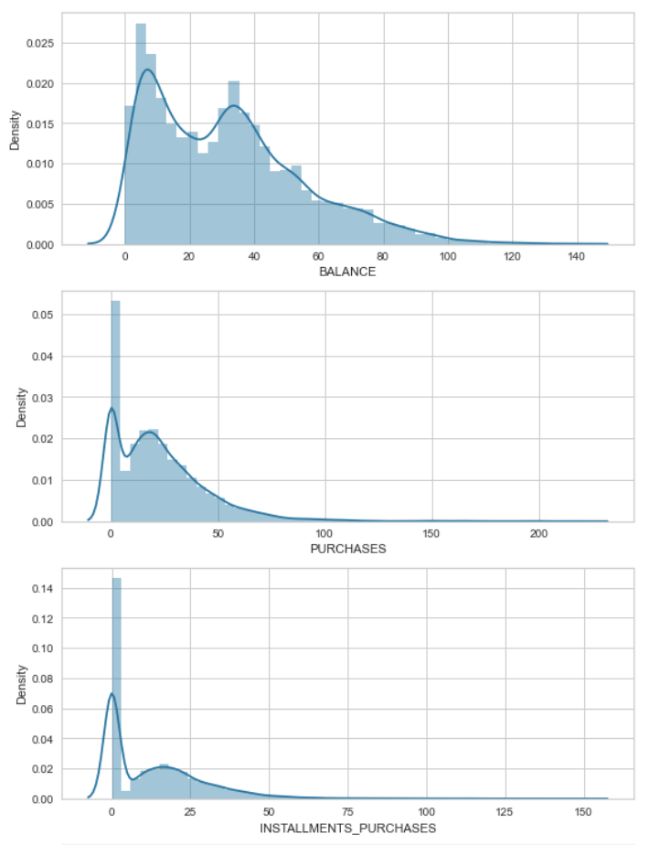
The Data is highly Skewed, I tried to fix it with the using Square Root Method:
Skewed data sample
Skewness rate
After Applying Square Root
z

Slide 5
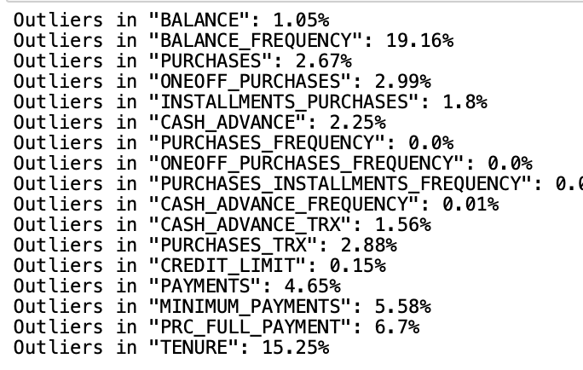
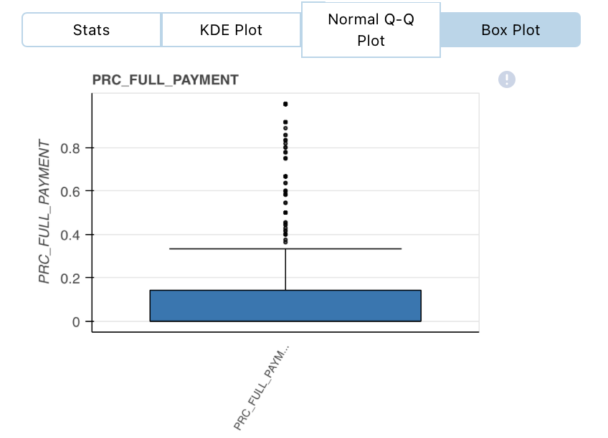
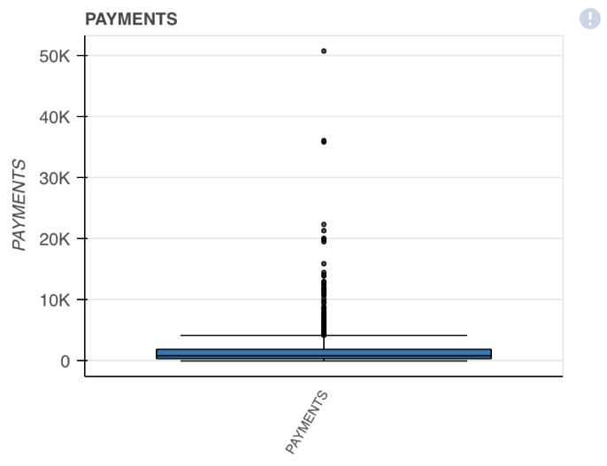
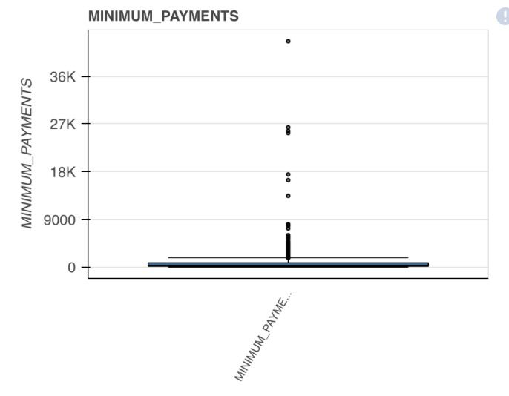
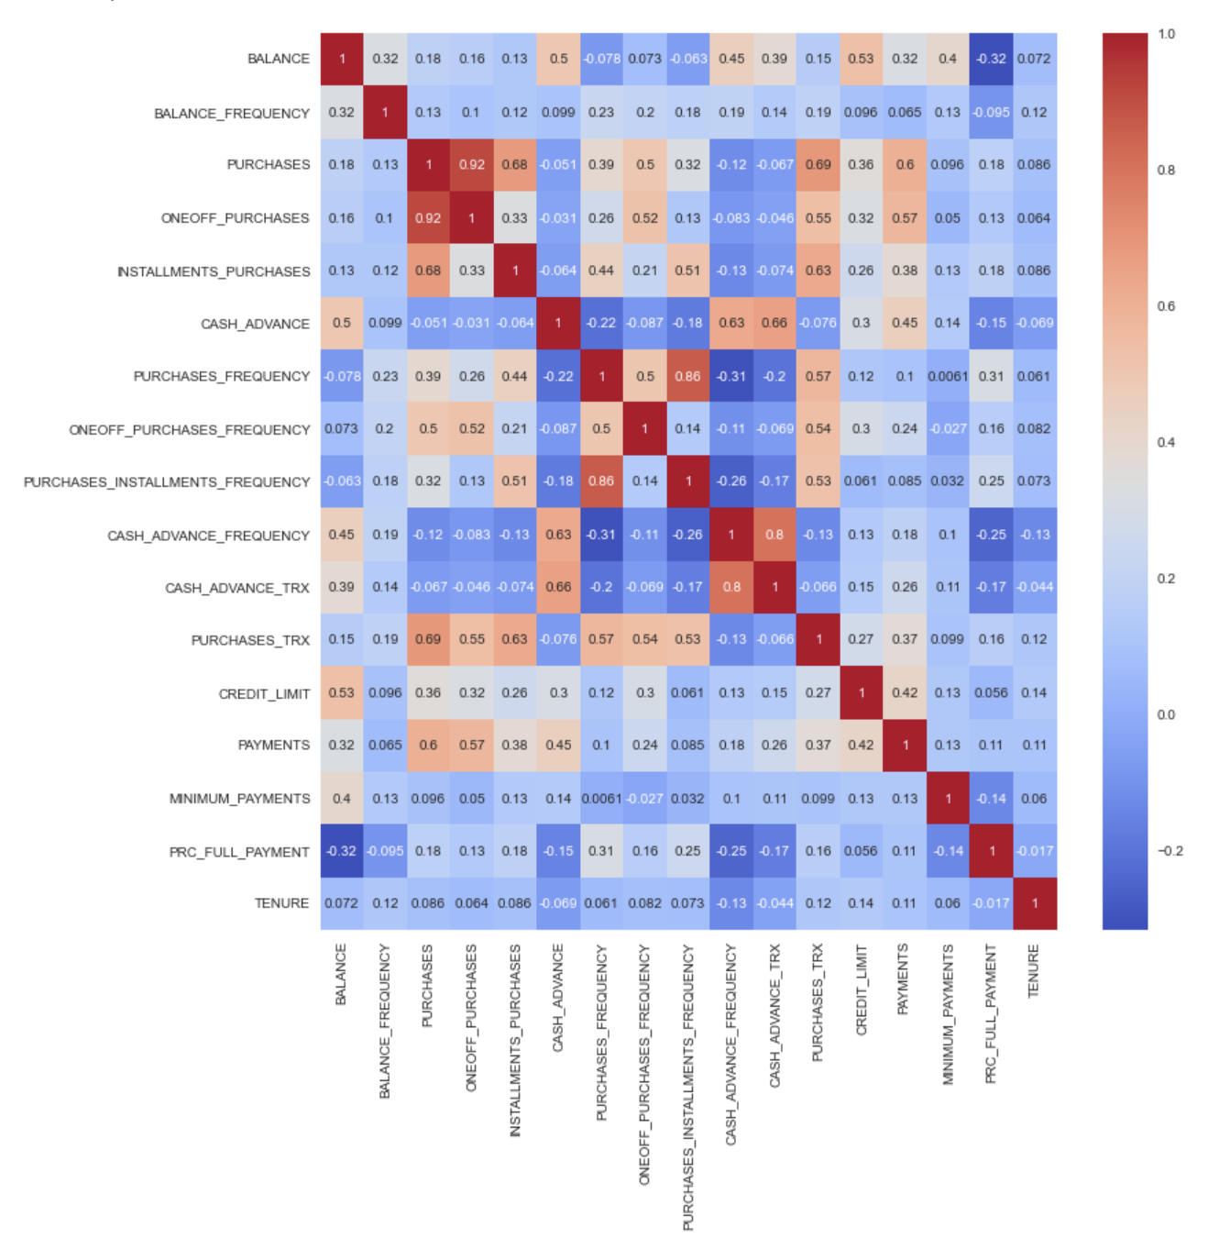
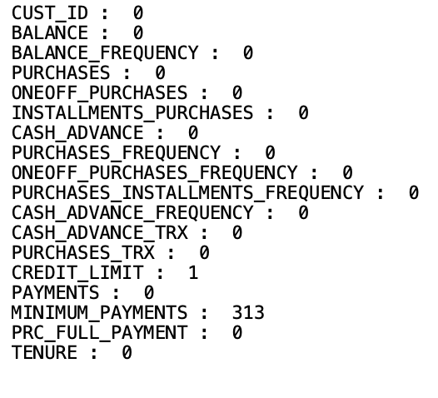
The Data has high rate of outliers, I handled them using IQR:
Since the Minimum_Payments Column has outliers, the median would be a good estimator for the null values,
also Dropping the missing value in the Credit_Limit column as it weights only 0.01 of the column values
z

Slide 6
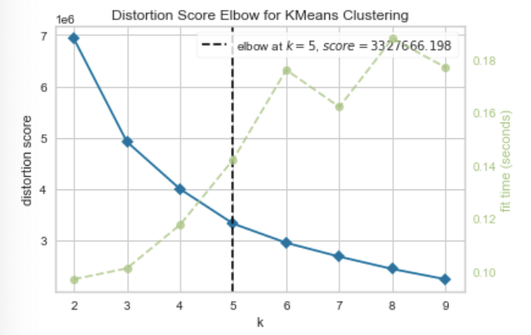
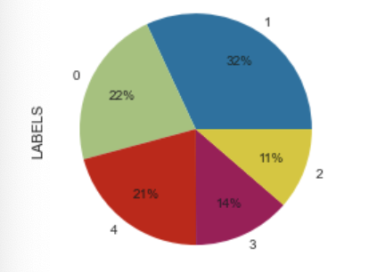
Modeling Using K-Means:
1. Distribution Visualizer elbow value:
2. Labels after PCA:

Slide 7
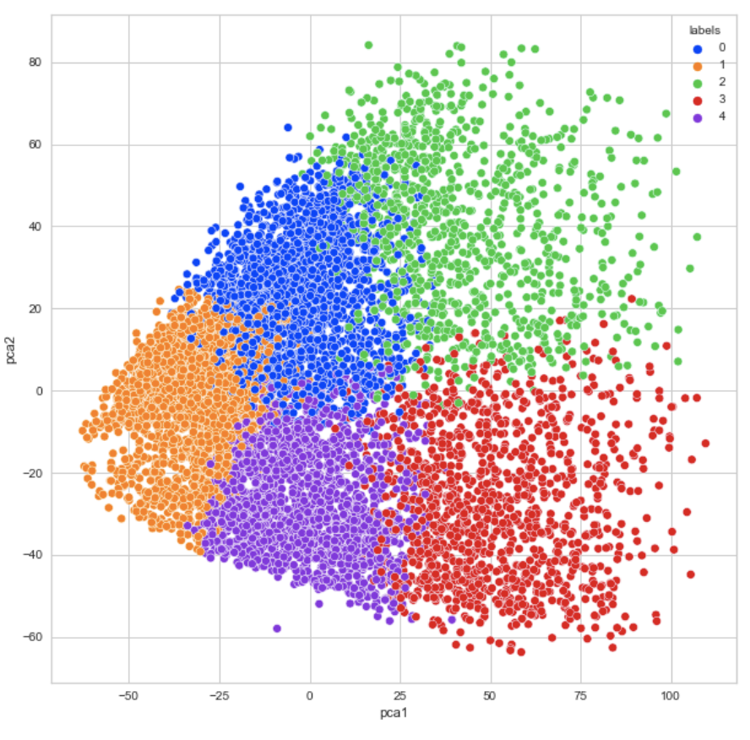
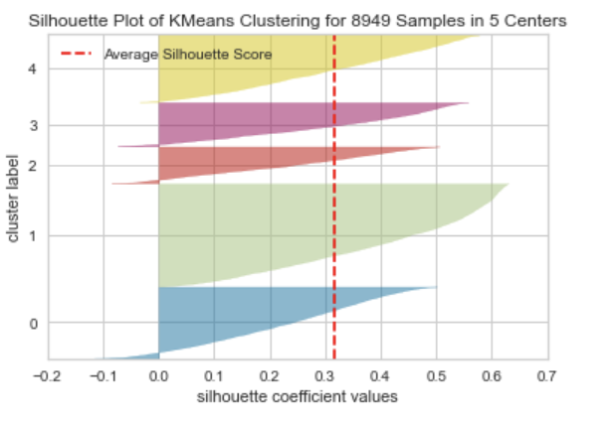
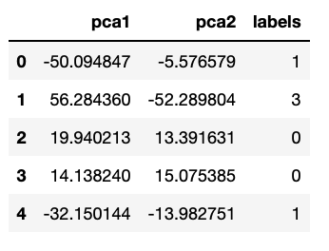

Model Evaluation:
z

Slide 8
Thank You.
z

